Slide 1
CSE115
Lecture 10
Dr. Mohammad Abu Yousuf (MAY)

Slide 2
RECURSION
Recursion is a process by which a function calls itself repeatedly, until some specified condition has been satisfied.

Slide 3
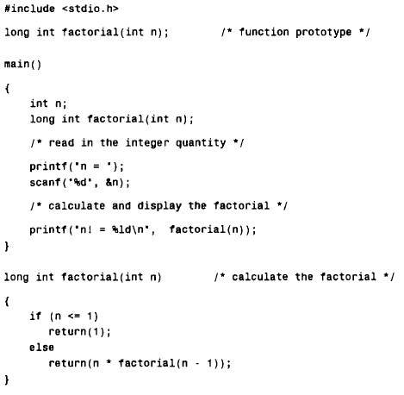

Slide 4
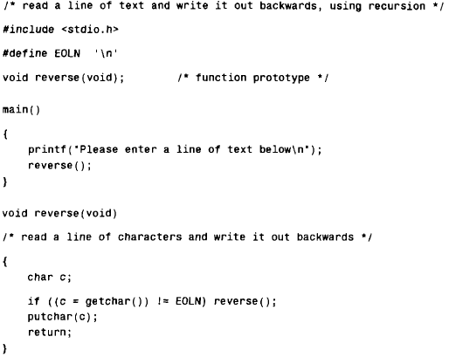

Slide 5
Output:
Now is the time for all good men to come to the aid of their country!
!yrtnuoc r i e h t fo dia eht ot emoc ot nem doog lla rof emit eht si woN

Slide 6
The Towers of Hanoi :
The Towers of Hanoi is a well-known children's game, played with three poles and a number of different-sized disks. Each disk has a hole in the center, allowing it to be stacked around any of the poles. Initially, the disks are stacked on the leftmost pole in the order of decreasing size, i.e., the largest on the bottom and the smallest on the top.
The object of the game is to transfer the disks from the leftmost pole to the rightmost pole, without ever placing a larger disk on top of a smaller disk. Only one disk may be moved at a time, and each disk must always be placed around one of the poles.

Slide 7
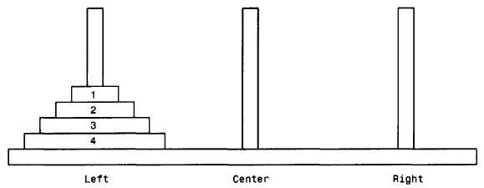

Slide 8
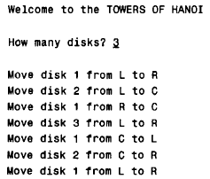
For the case where n =3, the following output is obtained

Slide 9
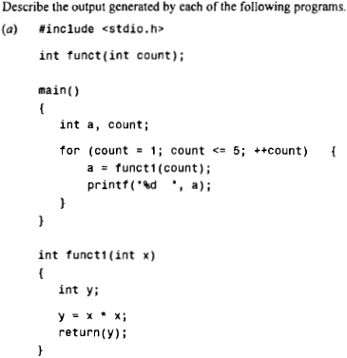
Find output

Slide 10
Output of previous program: 1 4 9 16 25

Slide 11
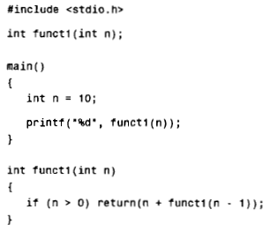

Slide 12
Output of previous program : 55

Slide 13
Global and local variables
A local variable is a variable that is declared inside a function. A global variable is a variable that is declared outside all functions.
A local variable can only be used in the function where it is declared. A global variable can be used in all functions.

Slide 14
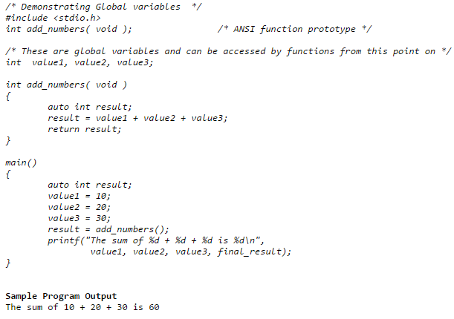

Slide 15
ARRAY

Slide 16
What is array ?
Many applications require the processing of multiple data items that have common characteristics (e.g., a set of numerical data, represented by xI, x2, . . . ,xn). In such situations it is often convenient to place the data items into an array, where they will all share the same name (e.g., x). The individual data items can be characters, integers, floating-point numbers, etc. However, they must all be of the same type.
Each array element (i.e., each individual data item) is referred to by specifying the array name followed by one or more subscripts, with each subscript enclosed in square brackets. Each subscript must be expressed as a nonnegative integer. In an n-element array, the array elements are x [0], x[1], x[2] . . . ,x [n – 1]

Slide 17
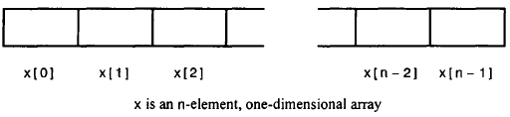
Defining a array
type array_name [array_size];
This is called a single-dimensional array. The array_size must be an integer constant greater than zero and type can be any valid C data type.
int x[100];
char text [80] ;

Slide 18
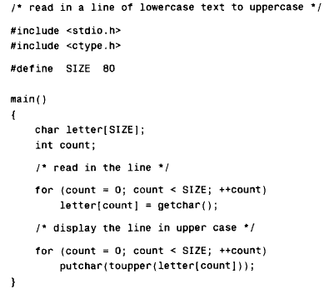

Slide 19
several array definitions that include the assignment of initial values :
int digits[10] = (1, 2, 3, 4, 5 , 6, 7, 8, 9, 10);
char color[3] = { 'R' , 'E', 'D' } ;
digits[0] = 1 color[0] = 'R'
digits[1] = 2 color[1] = 'E'
digits[2] = 3 color[2] = ' D '
digits[3] = 4
digits[4] = 5
digits[5] = 6
digits[6] = 7
digits[7] = 8
digits[8] = 9
digits[9] = 10

Slide 20
char color[3] = "RED”;
The number of values between braces { } can not be larger than the number of elements that we declare for the array between square brackets [ ].

Slide 21

int digits[5] = {3, 3, 3);
digits[0] = 3
digits[1] = 3
digits[2] = 3
digits[3] = 0
digits[4] = 0
If you omit the size of the array, an array just big enough to hold the initialization is created. Therefore, if you write:
double balance[ ] = {1000.0, 2.0, 3.4, 17.0, 50.0};
You will create exactly the same array

Slide 22
Example
Calculate Average Using Arrays
This program takes n number of element from user(where, n is specified by user), stores data in an array and calculates the average of those numbers.

Slide 23
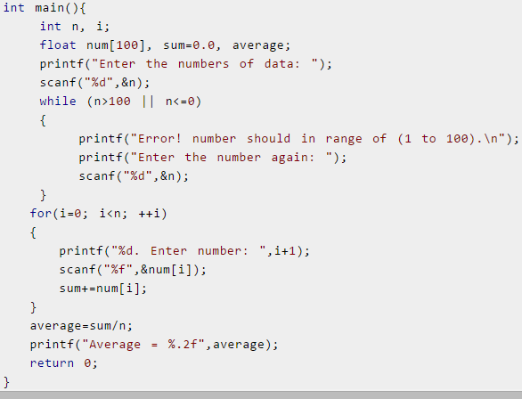

Slide 24
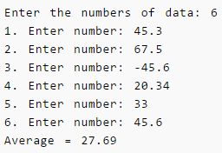
Output:

Slide 25
Display Largest Element of an array
This program takes n number of element from user(where, n is specified by user) and stores data in an array. Then, this program displays the largest element of that array using loops.

Slide 26
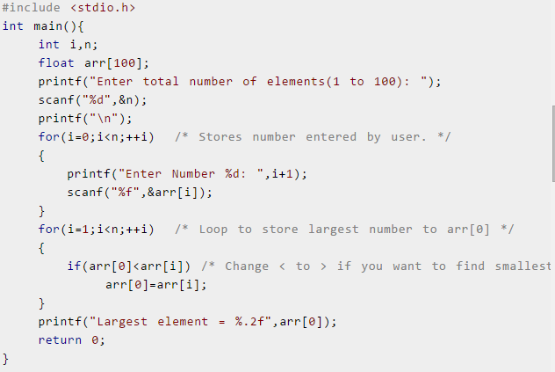

Slide 27
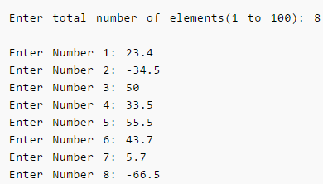
Output:
Largest element= 55.5

Slide 28
PASSING ARRAYS TO FUNCTIONS
An entire array can be passed to a function as an argument. The manner in which the array is passed differs markedly, however, from that of an ordinary variable.
To pass an array to a function, the array name must appear by itself, without brackets or subscripts, as an actual argument within the function call. The corresponding formal argument is written in the same manner, though it must be declared as an array within the formal argument declarations.
When declaring a one dimensional array as a formal argument, the array name is written with a pair of empty square brackets. The size of the array is not specified within the formal argument declaration.
Some care is required when writing function prototypes that include array arguments. An empty pair of square brackets must follow the name of each array argument, thus indicating that the argument is an array. If argument names are not included in a function declaration, then an empty pair of square brackets must follow the array argument data type.

Slide 29
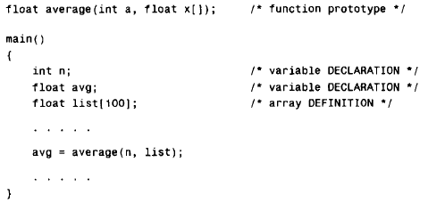

Example:

Slide 30
Example
Write a C program that passes a three-element integer array to a function, where the array elements are altered. The values of the array elements are displayed at three different places in the program, thus illustrating the effects of the alterations.

Slide 31
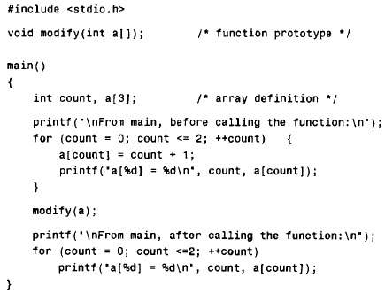
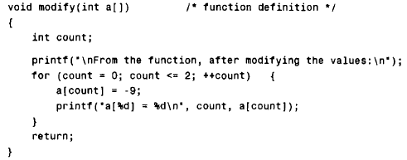

Slide 32
